Slide 1

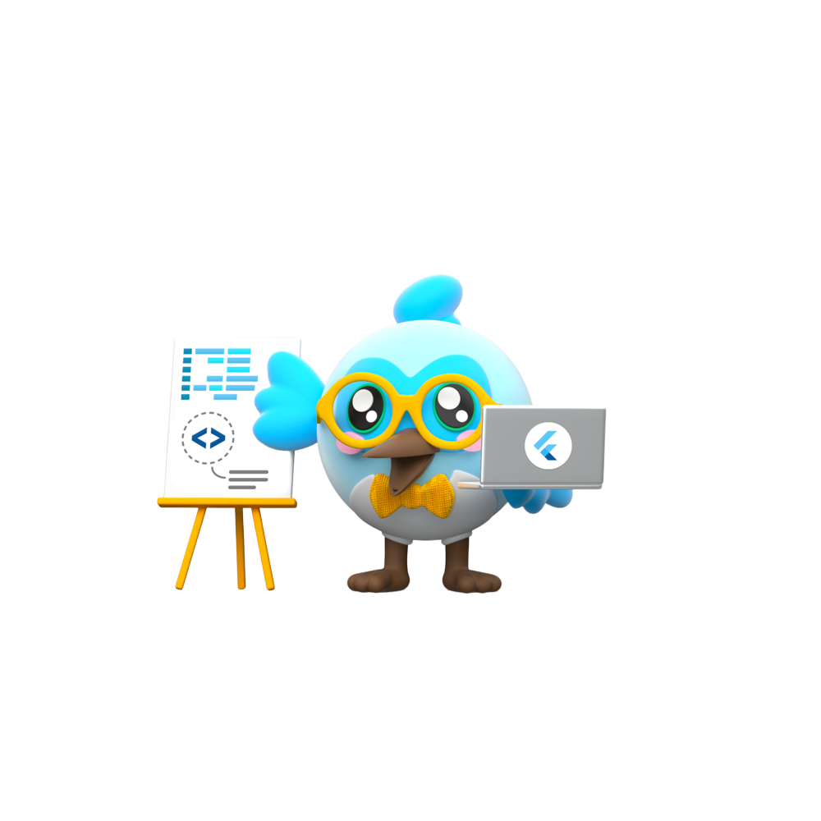

Slide 2





Slide 3


Slide 4
Agenda
1
Basic Programming concepts
2
About Tools
3
Design Patterns & Clean Architecture
4
Native App Development
5
Dart Basics
6
Flutter 0 to Pro

Slide 5

Basic Programming Concepts
Abstraction
Class
Inheritance
Control Structures
Encapsulation
Data Structures
Polymorphism
Syntax
&
Objects

Slide 6





About Tools

Slide 7
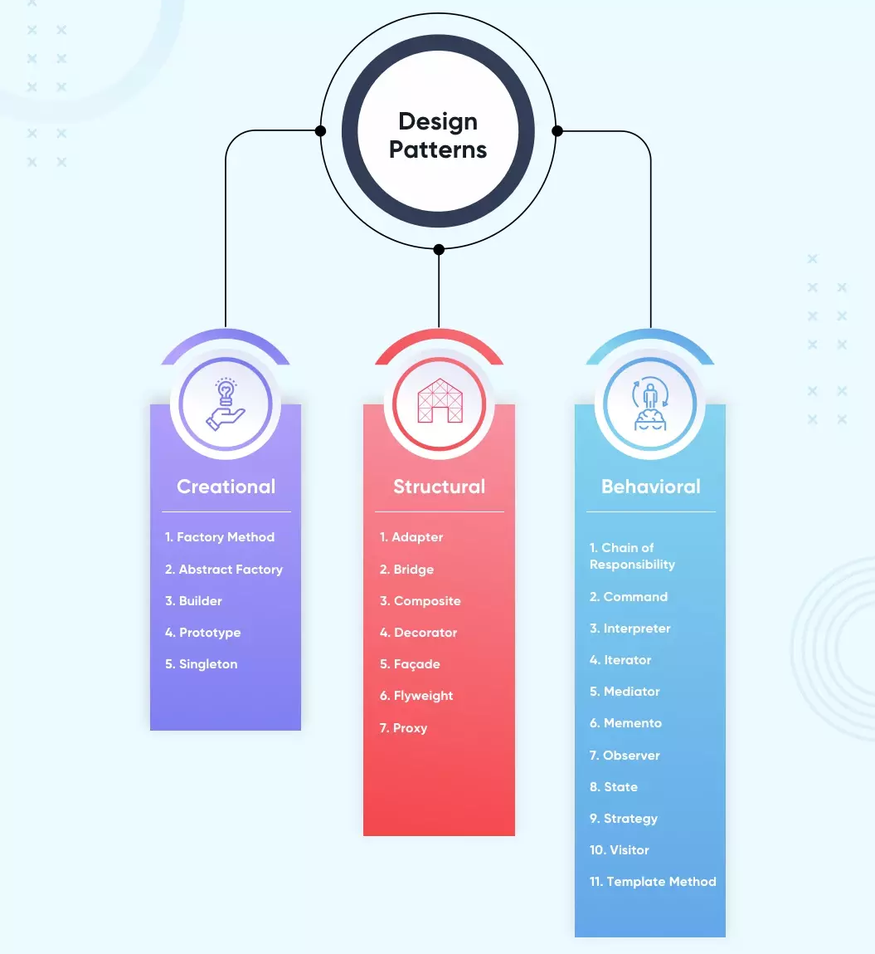
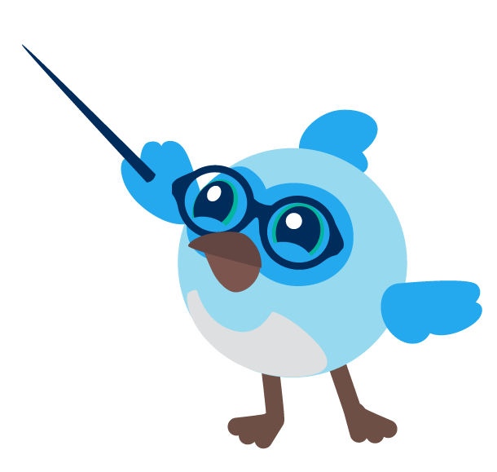
Design Patterns

Slide 8
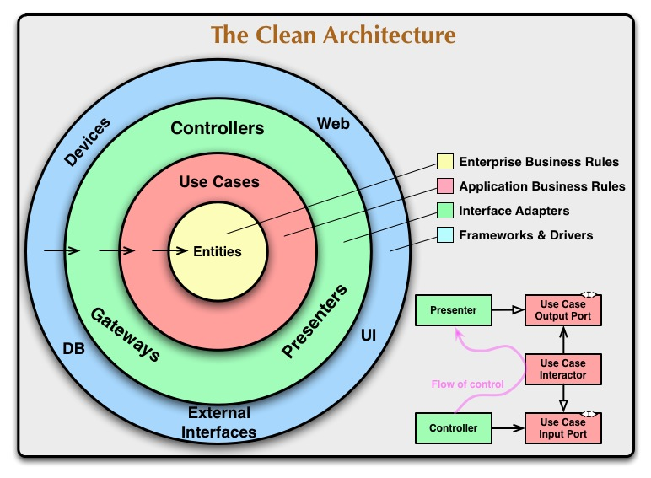
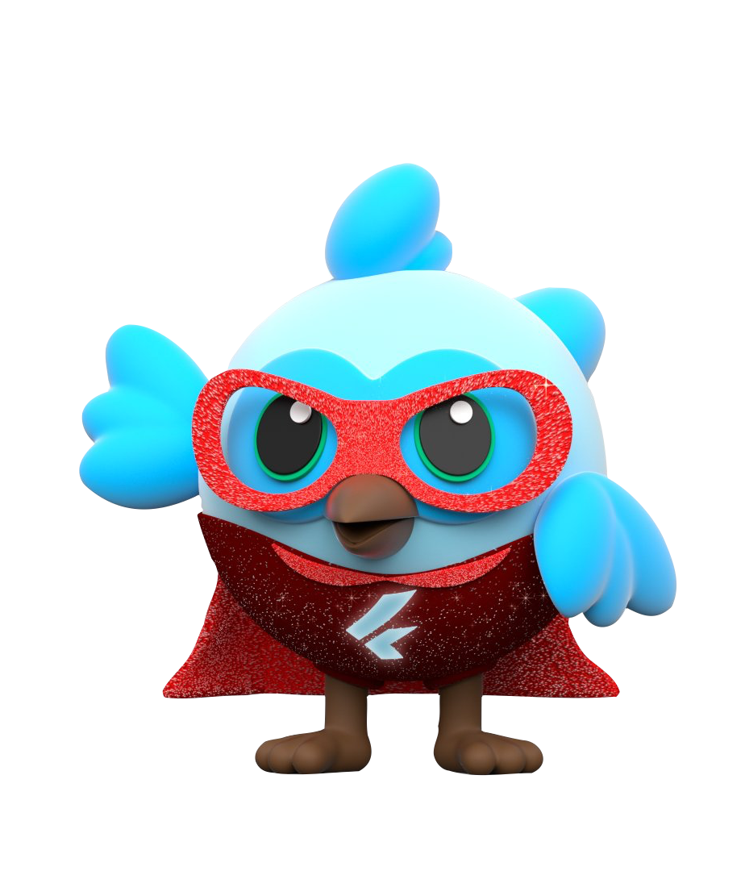

Slide 9
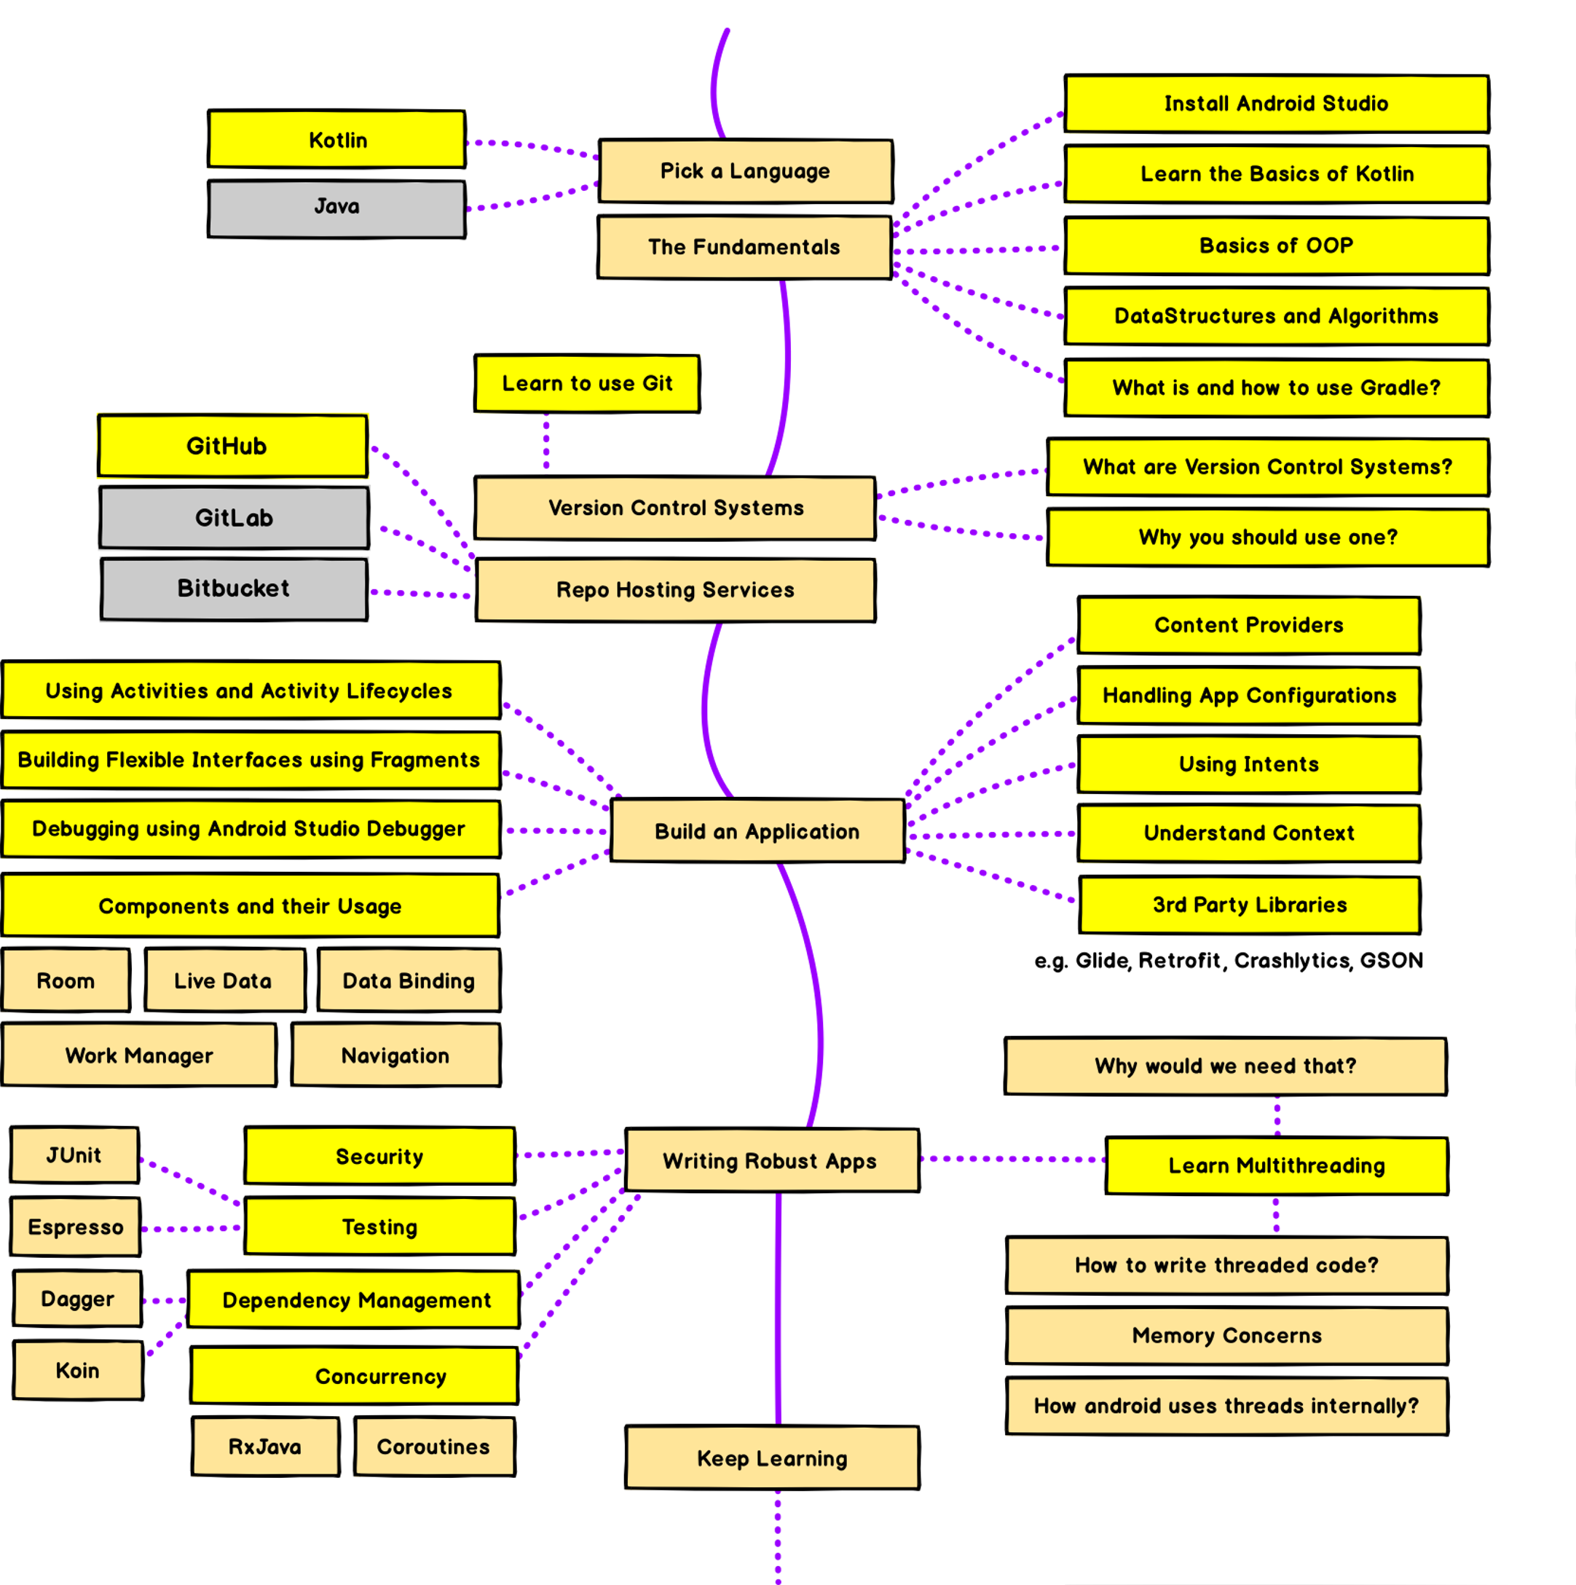


Slide 10
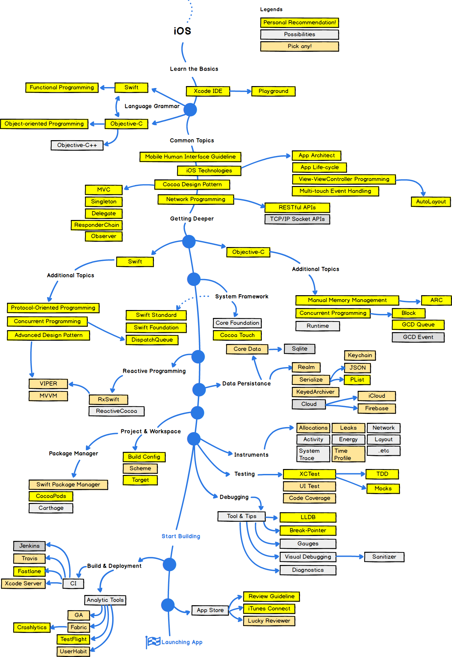
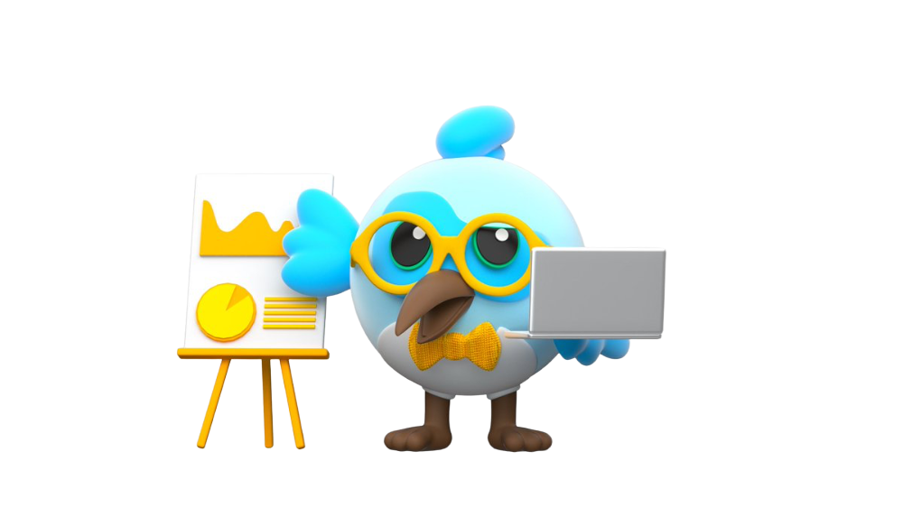

Slide 12



Slide 13


Why Dart?

Slide 14
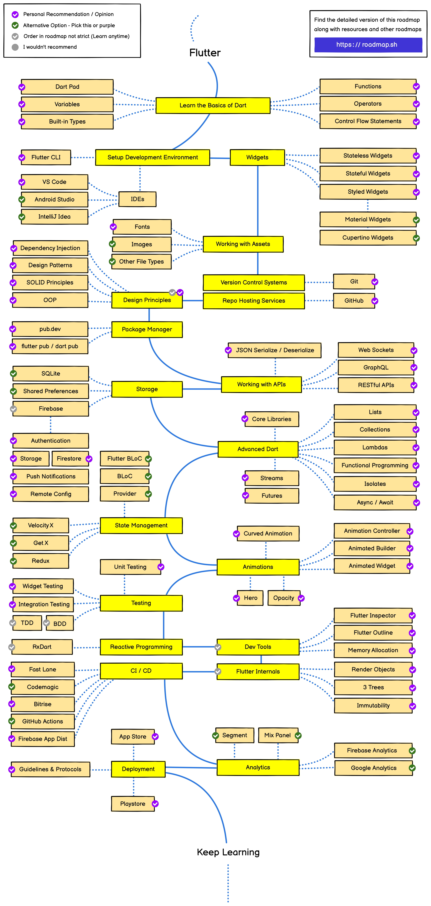
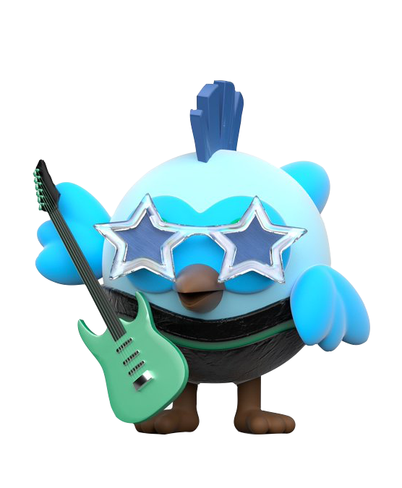

Slide 15
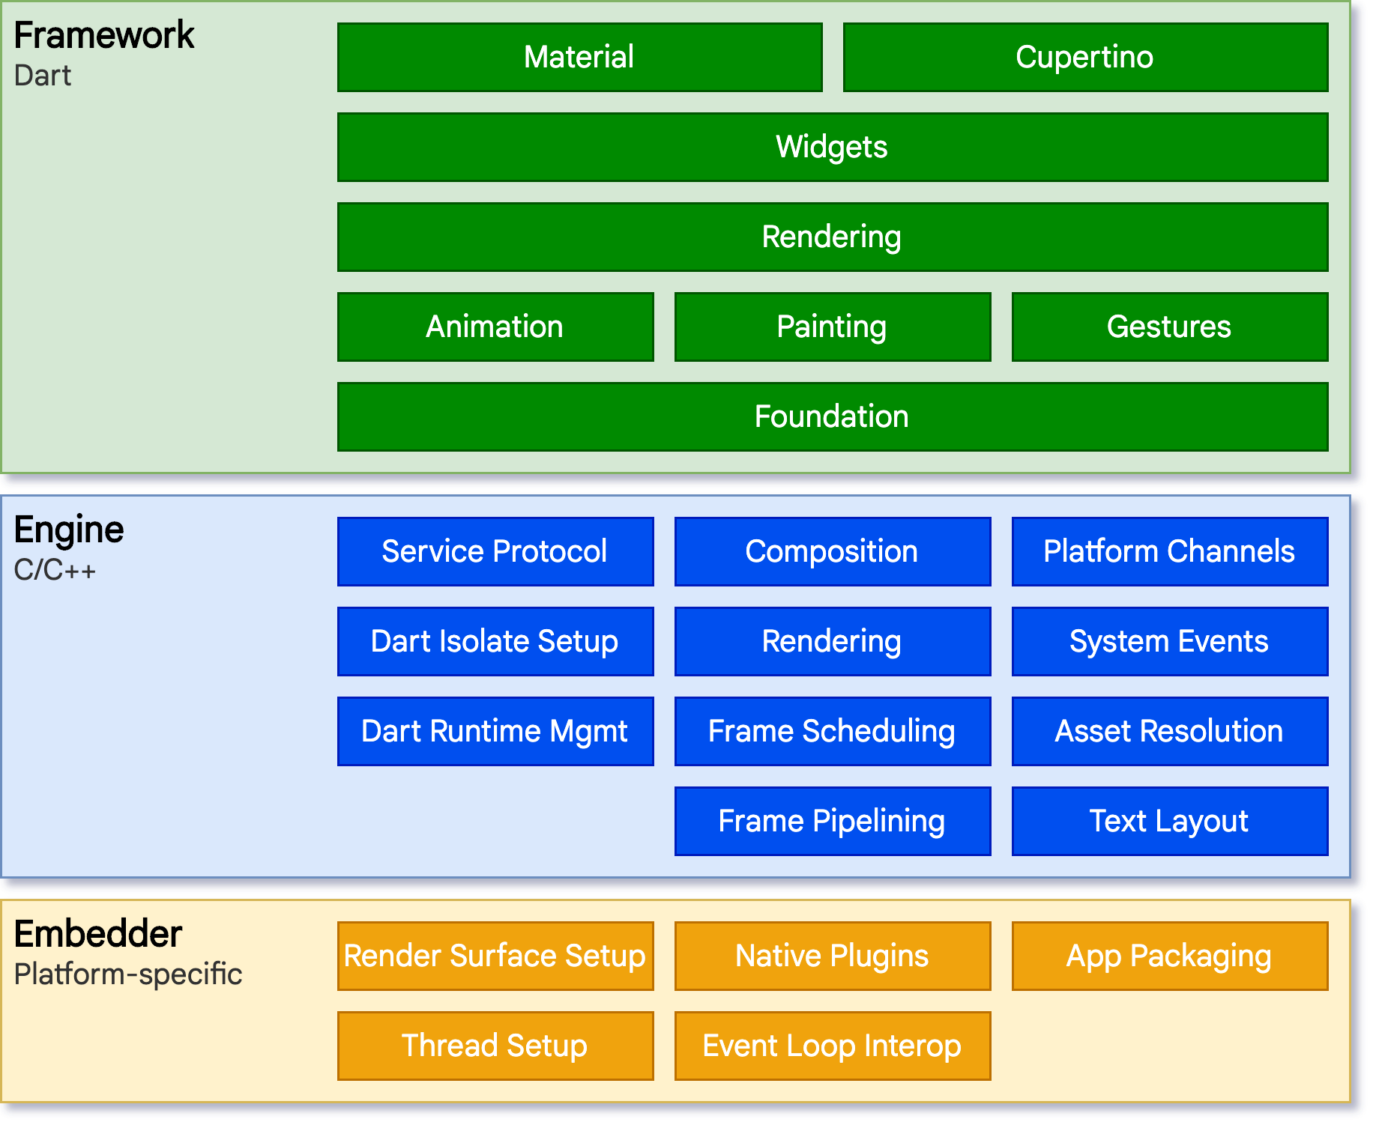


Slide 16
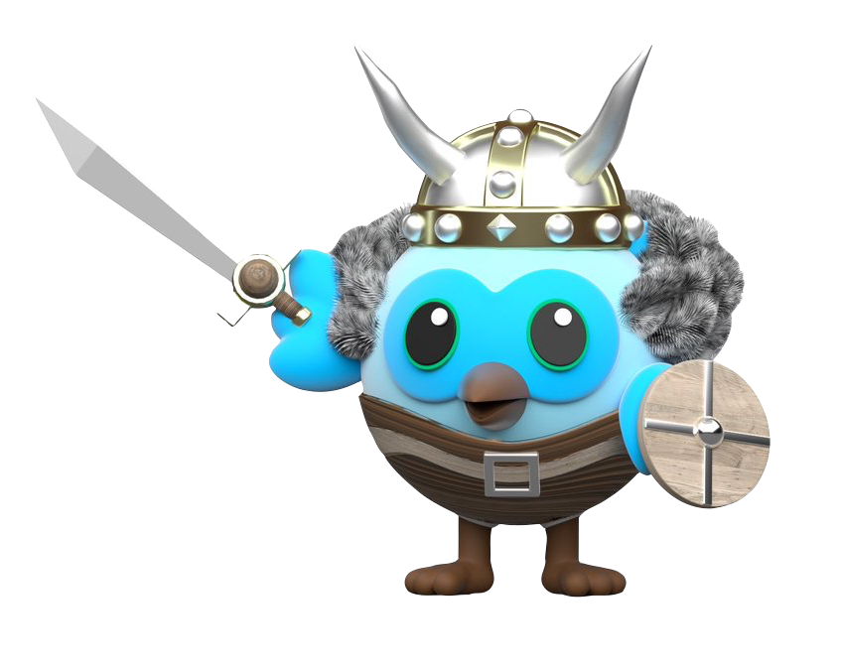

Slide 17

Community Support

Slide 18


References
Flutter official doc - https://flutter.dev/
Dart doc - https://dart.dev/
Online IDE – https://dartpad.dev/
Tools - https://developer.android.com/studio
Flutter SDK - https://flutter.dev/docs/get-started/install/macos
Code-Labs by Google - https://codelabs.developers.google.com

Slide 19
Begin at the beginning and go on till you come to the end: then stop.
— Lewis Carroll

Slide 20
Questions?

Slide 21





https://github.com/hemandroid
https://twitter.com/hemandroid
https://www.linkedin.com/in/hemandroid

Slide 22


